Slide 1
Client Server Concepts DNS, Telnet, FTP
Gaddafi Abdul-Salaam
Dept. of Computer Science
KNUST

Slide 2
Client-server model
Standard model for developing network applications
Notion of client and server
a server is a process that is offering some service.
A client is a process that is requesting the service
Server or client may be running on different machines
Server waits for requests from client(s)

Slide 3
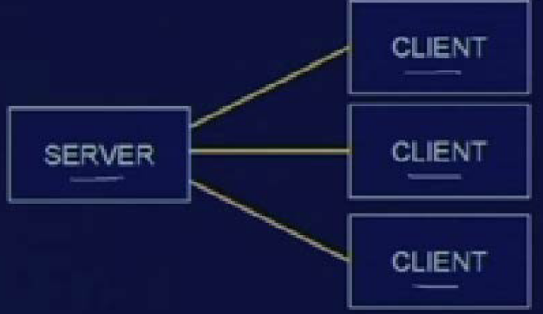
Client-server model (contd.)

Slide 4
Client-server model (contd.)
Typical scenario :
The server process (programme in execution) starts on some computer system
Initializes itself, then goes to sleep waiting for a client request.
A client process starts either on the same system or on some other system
Send a request to the server

Slide 5
Client-server model (contd.)
When the server process has finished providing its service to the client, it goes back to sleep, waiting for the next client request.
The process repeats

Slide 6
Client-server model (contd.)
Roles of the client and the server are asymmetric
Two types of servers:
Iterative server
Concurrent server

Slide 7
Iterative Servers
Used when the server process knows in advance how long it takes to handle each request and it handles each request itself.
Single copy of server runs at all times
A client may have to wait if the server is busy.

Slide 8
Concurrent server
Used when the amount of work required to handle a request is unknown; the server starts another process to handle each request.
A copy of the server caters to a client’s request in a dedicated fashion.
As many copies of server as there are client request.
Process copying - FOCKING

Slide 9
Using TCP or UDP
Before start of communication, a connection has to be established the two hosts
Five components in a connection
Protocol used
Source IP address
Source port number
Destination IP address
Destination port number

Slide 10
Develop a network application
The best way is to use some standard and well accepted protocol.
At th data link layer level use Ethernet
At the network layer level use IP
At the transport layer level use TCP
At the application layer level, use standard API like the Berkeley Socket Interface

Slide 11
What is a socket
The socket is the BSD (Berkelys socket distribution) method for achieving Inter Process Communication (IPC)
It is used to allow one process to speak to another (on same or different machines)
Anology: is like the telephone is used to allow one person to speak to another

Slide 12
Basic idea
When two processes located on two machines communicate, we define association and socket.
FULL Association: basically a 5 tuples
Protocol
Local IP address
Local port number
Emote IP address
Remote port number

Slide 13
Socket: also called half-association (a 3-tuple)
Protocol, local IP address, local port number
Protocol, remote IP address, remote port number

